Slide 1
Chapter 7 Discrete Probability
Section 2
Probability Theory

Slide 2
Outline
Introduction
Random Variables
Discrete Probability Distribution
Bernoulli Trials
Independent Events
Conditional Probability

Slide 3
Introduction
Random variable (随机变量)
  A random variable V is any variable whose value is unknown, or whose value depends on the precise situation.
    E.g., the number of students in class today
    Whether it will rain tonight (Boolean variable)
  The proposition V = v_{i} (V takes v_{i} as its value) may have an uncertain truth value, and may be assigned a probability.
Example.
  A fair coin is flipped 3 times. We have 2³ = 8 possible outcomes - (TTT), (TTH), (THH), (HTT), (HHT), (HHH), (THT), (HTH).
  Let V be a random variable that assignees to the number of heads in this outcome. V can takes one in {0, 1, 2, 3} as its value, with no idea before the end of the third flipping.

Slide 4
Introduction
  Random variable V is a function V: S → V(S), where S = {(TTT), (TTH), (THH), (HTT), (HHT), (HHH), (THT), (HTH)} is the domain of V and V(S) = {0, 1, 2, 3} is the range of V, which is the number of heads, and
    V(TTT) = 0,
    V(TTH) = V(HTT) = V(THT) = 1,
    V(HHT) = V(THH) = V(HTH) = 2,
    V(HHH) = 3.

Slide 5
Introduction
PDF of random variable (随机变量的概率分布函数)
  The probability distribution (PDF) of random variable V is given by
      P(V=3) = 1/8
      P(V=2) = 3/8
      P(V=1) = 3/8
      P(V=0) = 1/8

Slide 6
Introduction
Experiments & Sample Spaces (试验与样本空间)
  A (stochastic) experiment is any process by which a given random variable V gets assigned some particular value, and where this value is not necessarily known in advance.
    We call it the “actual” value of the variable V, as determined by that particular experiment.
  The sample space S of the experiment is just the domain of the random variable,
  S = dom[V].
  The outcome of the experiment is the specific value v_{i} of the random variable V that is selected.

Slide 7
Introduction
Event (事件)
  An event E is any set of possible outcomes in S. That is,
  E ⊆ S = dom[V].
  The event E= {(TTT), (TTH), (HTT), (THT)} that means “less than 2 heads show up in three times of flipping” is represented as the set {0, 1} of values of the variable V = (# of heads), or V(E) = {0, 1}.
  We say that event E occurs when the actual value of V is in E, which may be written V∈E.
    Note that V∈E denotes the proposition (of uncertain truth) asserting that the actual outcome (value of V) will be one of the outcomes in the set E.

Slide 8
Introduction
Probability (概率)
  The probability p = Pr[E]∈[0,1] of an event E is a real number representing our degree of certainty that E will occur.
    If Pr[E] = 1, then E is absolutely certain to occur,
      thus V∈E has the truth value True.
    If Pr[E] = 0, then E is absolutely certain not to occur,
      thus V∈E has the truth value False.
    If Pr[E] = ½, then we are maximally uncertain about whether E will occur; that is,
      V∈E and V∉E are considered equally likely.
    How do we interpret other values of p?

Slide 9
Introduction
Probability
  Several alternative definitions of probability are commonly encountered:
    Frequentist, Bayesian, Laplacian, Axiomatic
  They have different strengths & weaknesses, philosophically speaking.
    But fortunately, they coincide with each other and work well together, in the majority of cases that are typically encountered.

Slide 10
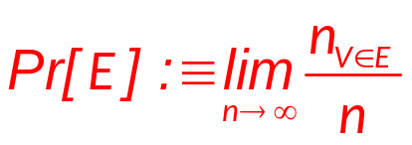
Introduction
Probability - Frequentist Definition
  The probability of an event E is the limit, as n→∞, of the fraction of times that we find V∈E over the course of n independent repetitions of (different instances of) the same experiment.
  Some problems with this definition:
    It is only well-defined for experiments that can be independently repeated, infinitely many times.
      or at least, if the experiment can be repeated in principle, e.g., over some hypothetical ensemble of (say) alternate universes.
    It can never be measured exactly in finite time!
  Advantage: an objective, mathematical definition.

Slide 11
Introduction
Probability - Bayesian Definition
  Suppose a rational, profit-maximizing entity R is offered a choice between two rewards:
    Winning $1 if and only if the event E actually occurs.
    Receiving p dollars (where p∈[0,1]) unconditionally.
  If R can honestly state that he is completely indifferent between these two rewards, then we say that R’s probability for E is p, that is, Pr_{R}[E] :≡ p.
  Problem: It’s a subjective definition; depends on the reasoner R, and his knowledge, beliefs, & rationality.
    The version above additionally assumes that the utility of money is linear. This assumption can be avoided by using “utils” (utility units) instead of dollars.

Slide 12
Introduction
Probability - Laplacian Definition
  First, assume that all individual outcomes in the sample space are equally likely to each other…
    Note that this term still needs an operational definition
  Then, the probability of any event E is given by
  Pr[E] = |E|/|S|
  Problems: Still needs a definition for equally likely, and depends on the existence of some finite sample space S in which all outcomes in S are, in fact, equally likely.

Slide 13
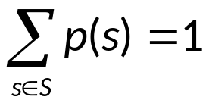
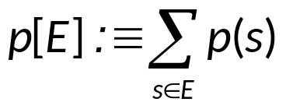
Introduction
Probability - Axiomatic Definition
  Let p be any total function p: S→[0,1] such that
  Such a p is called a probability distribution.
  Then, the probability under p of any event E⊆S is just:
  Advantage: Totally mathematically well-defined.
    This definition can even be extended to apply to infinite sample spaces, by changing ∑ → ∫, and calling p a probability density function or a probability measure.
  Problem: Leaves operational meaning unspecified.

Slide 14
Introduction
The Axioms of Probability
  0 ≤ p(A) ≤ 1
  p(True) = 1
  p(False) = 0
  p(A or B) = p(A) + p(B) - p(A and B)
  Theorems
    p(not A) = p(~A) = 1-p(A)
    p(A) = p(A∧B) + p(A∧~B)

Slide 15
Introduction
The Axioms of Probability
  There have been attempts to do different methodologies for uncertainty
    Fuzzy Logic (模糊逻辑)
    Three-valued logic (三值逻辑)
    Dempster-Shafer (证据理论)
    Non-monotonic reasoning (非单调推理)
  But the axioms of probability are the only system with this property:
    If you gamble using them you can’t be unfairly exploited by an opponent using some other system [di Finetti 1931]

Slide 16
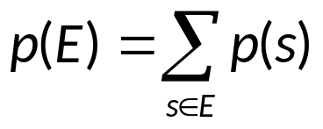
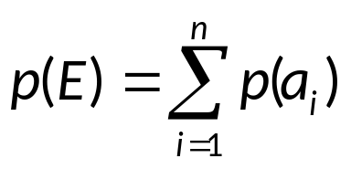
Introduction
Probability of an event E
  The probability of an event E is the sum of the probabilities of the outcomes in E. That is
  Note that, if there are n outcomes in the event E, that is, if E = {a₁, a₂, …, a_{n}} then

Slide 17
Introduction
Probability of an event E
  Example:
    What is the probability that, if we flip a coin three times, that we get an odd number of tails?
  Ans.
    The sample space is {(TTT), (TTH), (THH), (HTT), (HHT), (HHH), (THT), (HTH)}
    Each outcome has probability 1/8
    p(odd number of tails) = 1/8+1/8+1/8+1/8 = 1/2

Slide 18
Introduction
Visualizing sample Space
  Four methods to visualize sample space
    Listing
      S = {Head, Tail}
    Venn Diagram
    Contingency Table
    Decision Tree Diagram

Slide 19
Introduction
Visualizing sample Space
  Venn Diagram
    Experiment: Toss 2 Coins & Note Faces
Event “Tail”
TH
HH
TT
HT
    S = {HH, HT, TH, TT}
Sample Space

Slide 20
Introduction
Visualizing sample Space
  Contingency Table
    Experiment: Toss 2 Coins & Note Faces
1st coin | 2nd Coin
 | Head | Tail | Total
Head | HH | HT | HH, HT
Tail | TH | TT | TH, TT
Total | HH, TH | HT, TT | S
Simple
Event
(Head on
1st Coin)
    S = {HH, HT, TH, TT}
Sample Space

Slide 21
Introduction
Visualizing sample Space
  Tree Diagram
    Experiment: Toss 2 Coins & Note Faces
H
HH
H
T
HT
H
TH
T
T
TT
    S = {HH, HT, TH, TT}
Sample Space

Slide 22
Discrete Probability Distribution
Discrete Random Variable (离散随机变量)
  Possible values (outcomes) are discrete
    E.g., natural number (0, 1, 2, 3 etc.)
  Obtained by Counting
  Usually Finite Number of Values
    But could be infinite (must be “countable”)

Slide 23
Discrete Probability Distribution
Discrete Probability Distribution (离散概率分布)
(also called probability mass function, PMF 概率质量函数)
  List of All possible [x, p(x)] pairs
    x = Value of Random Variable (Outcome)
    p(x) = Probability Associated with Value
  Mutually Exclusive (No Overlap)
  Collectively Exhaustive (Nothing Left Out)
  0 ≤ p(x) ≤ 1
  ∑ p(x) = 1

Slide 24
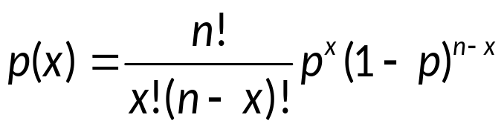
Discrete Probability Distribution
Visualizing Discrete Probability Distributions
Table
Listing
{ (0, .25), (1, .50), (2, .25) }
#Tails | F(x) Count | P(x)
0 | 1 | .25
1 | 2 | .50
2 | 1 | .25
p(x)
.50
.25
.00
Graph
Equation
x
0 1 2

Slide 25
Discrete Probability Distribution
Arity of Random Variables (随机变量的元数)
  A is a random variable with arity k if it can take exactly one value out of {v₁,v₂, ..., v_{k}}
  Thus
  p(A=v_{i} ∧ A=v_{j}) = 0 if i ≠ j
  p(A=v₁ ∨ A=v₂ ∨ … ∨ A=v_{k}) = 1

Slide 26
Discrete Probability Distribution
Mutually Exclusive Events (互斥事件)
  Two events E₁, E₂ are called mutually exclusive if they are disjoint:
  E₁∩E₂ = ∅
    Note that two mutually exclusive events cannot both occur in the same instance of a given experiment.
  For mutually exclusive events,
  Pr[E₁∪E₂] = Pr[E₁] + Pr[E₂].

Slide 27
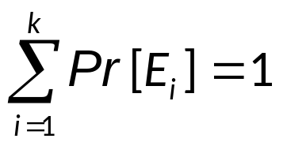
Discrete Probability Distribution
Exhaustive Sets of Events (事件完备集)
  A set E = {E₁, E₂, …} of events in the sample space S is called exhaustive iff ∪E_{i} = S .
  An exhaustive set E = {E₁, E₂, …, E_{k} } of events that are all mutually exclusive with each other is a partition of S and has the property that

Slide 28
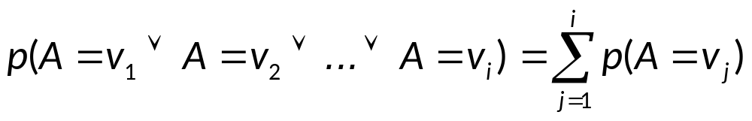
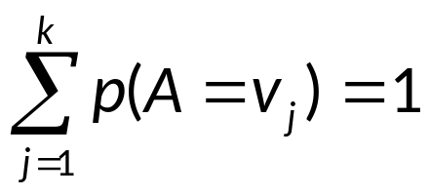
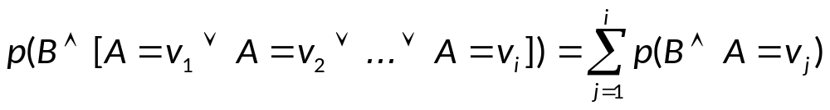
Discrete Probability Distribution
Some facts about Multi-valued Random Variables
  Let A be a random variable with arity k. Using the axioms of probability
      0 ≤ p(A) ≤ 1, p(True) = 1, p(False) = 0
      p(A or B) = p(A) + p(B) - p(A and B)
  and p(A=v_{i} ∧ A=v_{j}) = 0 if i ≠ j
  p(A=v₁ ∨ A=v₂ ∨ … ∨ A=v_{k}) = 1
  It’s not hard to prove that

Slide 29


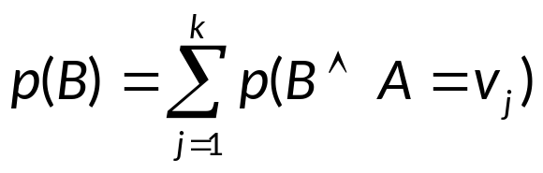
Discrete Probability Distribution
Elementary Probability Rules
  Let A be a random variable with arity k.

Slide 30
Bernoulli Trials
Bernoulli trial (贝努利试验)
  Each performance of an experiment with only two possible outcomes is called a Bernoulli trial.
  In general, a possible outcome of a Bernoulli trial is called a success or a failure.
  If p is the probability of a success and q is the probability of a failure, then
  p + q = 1

Slide 31
Bernoulli Trials
Example.
  A coin is biased so that the probability of heads is 2/3. What is the probability that exactly four heads come up when the coin is flipped seven times, assuming that the flips are independent?
  The number of ways that we can get four heads
  C(7,4) = 7!/4!3! = 7×5 = 35
  The probability of getting four heads and three tails
  (2/3)⁴ ×(1/3)³ = 16/3⁷
  So p(4 heads and 3 tails) is
  C(7,4)×(2/3)⁴×(1/3)³ = 35×16/3⁷ = 560/2187

Slide 32
Bernoulli Trials
Probability of k successes in n independent Bernoulli trials
  The probability of k successes in n independent Bernoulli trials, with probability of success p and probability of failure q = 1-p is
  C(n, k) p^{k} q^{n-k}
  Probability of no successes (k = 0)
  C(n, 0) p⁰ q^{n-0} = 1 (p⁰) (1-p)^{n} = (1-p)^{n}
  Probability of at least one success.
  1 - (1-p)^{n} (why?)

Slide 33
Bernoulli Trials
Probability of k successes in n independent Bernoulli trials
  Probability of at most one success (means there can be no successes or one success)
  C(n, 0) p⁰ q^{n-0} +C(n, 1) p¹ q^{n-1}
  = (1-p)^{n} + np(1-p)^{n-1}
  Probability of at least two successes.
  1 - (1-p)^{n} - np(1-p)^{n-1}

Slide 34
Bernoulli Trials
Example.
  A coin is tossed 8 times. What is the probability of exactly 3 heads in the 8 tosses? (THHTTHTT is a tossing sequence…)
  Solution.
  That is, the outcome consists of 3 heads and 5 tail. Let p=0.5, The answer is
  C(8, 3)×0.5³×0.5⁵ = C(8, 3)×0.5⁸

Slide 35
Bernoulli Trials
Example.
  A coin is flipped until it comes up tails. Assume that the probability the coin comes up tails is p. What is the probability that the experiment ends after n flips
  Solution.
  That is, the outcome consists of n-1 heads and a tail. The answer is
  (1-p)^{n-1} p

Slide 36
Probability vs. Odds
What’s Odds (几率)
  The term “odds” is widely used in the gambling community. It is very closely related, but not the same thing as probability.
  The odds in favor of an event E means the relative probability of E compared with its complement ~E.
  O(E) :≡ Pr(E)/Pr(~E).
    E.g., if p(E) = 0.6 then p(~E) = 0.4 and
    O(E) = 0.6/0.4 = 1.5.
  Odds are conventionally written as a ratio of integers.
    E.g., 3/2 or 3:2 in above example. “3 to 2 in favor.”
  The odds against E just means 1/O(E).
    E.g.,“2 to 3 against” in above example.

Slide 37
Probability vs. Odds
Example.
  Suppose an urn contains 4 blue balls and 5 red balls. An example experiment: Shake up the urn, reach in (without looking) and pull out a ball.
  A random variable V: Identity of the chosen ball.
  The sample space S: The set of all possible values of V. In this case, S = {b₁, b₂, …, b₉}
  An event E: “The ball chosen is blue”
Questions.
  What are the odds in favor of E?
  What is the probability of E?
b₁
b₂
b₉
b₇
b₃
b₅
b₄
b₈
b₆

Slide 38
Independent Events
Independent events. (独立事件)
  Two events E, F are called independent if
  Pr[E∩F] = Pr[E]·Pr[F]
  Relates to the product rule for the number of ways of doing two independent tasks.
  Example.
    Flip a coin, and roll a die.
    Pr[(coin shows heads) ∩ (die shows 1)] =
    Pr[coin is heads] × Pr[die is 1] = 1/2 × 1/6 = 1/12.

Slide 39

Independent Events
Example.
  Suppose a red die and a blue die are rolled. The sample space S (|S|=36):
 | 1 | 2 | 3 | 4 | 5 | 6
1 | × | × | × | × | × | ×
2 | × | × | × | × | × | ×
3 | × | × | × | × | × | ×
4 | × | × | × | × | × | ×
5 | × | × | × | × | × | ×
6 | × | × | × | × | × | ×
  Are the events “sum is 7” and “the blue die is 3” independent?

Slide 40
Independent Events
  Solution
  Let E₁ = “Sum is 7”
  E₂ = “Blue die is 3”
  Then
  |E₁| = 6
  |E₂| = 6
  |E₁∩E₂| = 1
  Thus
  p(E₁∩E₂) = 1/36
  p(E₁)×p(E₂) = (6/36)×(6/36) = 1/36 = p(E₁∩E₂)
  So the events “sum is 7” and “the blue die is 3” are independent
 | 1 | 2 | 3 | 4 | 5 | 6
1 | × | × | × | × | × | ×
2 | × | × | × | × | × | ×
3 | × | × | × | × | × | ×
4 | × | × | × | × | × | ×
5 | × | × | × | × | × | ×
6 | × | × | × | × | × | ×

Slide 41
Conditional Probability
Conditional Probability. (条件概率)
  Let E, F be any events such that Pr[F]>0. The conditional probability of E given F, written Pr[E|F], is defined as
  Pr[E|F] :≡ Pr[E∩F]/Pr[F].
  This is what the probability that E would turn out to occur should be, if we are given only the information that F occurs.
  If E and F are independent then Pr[E|F] = Pr[E].
    Pr[E|F] = Pr[E∩F]/Pr[F] = Pr[E]×Pr[F]/Pr[F] = Pr[E]

Slide 42
Conditional Probability
Example.
  Choose a single letter out of the 26-letter English alphabet, totally at random.
  Use the Laplacian assumption on the sample space {a,b,..,z}.
  What is the (prior) probability that the letter is a vowel?
    Pr[Vowel] = __ / __ .
  Now, suppose that the letter chosen happened to be in the first 9 letters of the alphabet.
    Now, what is the conditional (or posterior) probability that the letter is a vowel, given this information?
      Pr[Vowel | First9] = ___ / ___ .

Slide 43
Conditional Probability
Example.
1st 9
letters
vowels
z
w
k
r
b
c
a
t
y
u
d
f
x
e
s
o
i
g
l
h
p
n
j
v
q
m
Sample Space S

Slide 44
Conditional Probability
Example.
  What is the probability, if we flip a coin three times, that we get an odd number of tails (as event E), if we know that the event F, the first flip comes up tails occurs?
(TTT), (TTH), (THH), (HTT),
(HHT), (HHH), (THT), (HTH)
  Each outcome (out of erasing) has probability 1/4,
  p(E|F) = 1/4+1/4 = 1/2, where E=odd number of tails
  or p(E|F) = p(E∩F)/p(F) = 2/4 = 1/2
  For comparison p(E) = 4/8 = 1/2
  E and F are independent, since p(E|F) = Pr(E).

Slide 45
Conditional Probability
Example.
  A bit string of length 4 is generated at random so that each of the 16 bit strings is equally likely. What is the probability that it contains at least two consecutive 0s, given that its first bit is a 0?
  Solution.
  It’s to calculate: Pr(E|F) = Pr(E∩F) / Pr(F).
  where F is the event that “first bit is 0”, and E the event that “string contains at least two consecutive 0s”.
  Pr(F) = ½,
  Pr(E∩F) = 5/16: 0000 0001 0010 0011 0100 (note: 1st bit fixed to 0)
  So Pr(E|F) = Pr(E∩F) / Pr(F) = 5/8

Slide 46
Conditional Probability
Sample space
F
E
E∩F
0000
0001
0010
0011
0100
0101
0110
0111
1000
1001
1010
1011
1100
1101
1110
1111
0000
0001
0010
0011
0100
0101
0110
0111
0000
0001
0010
0011
0100
1000
1001
1100
0000
0001
0010
0011
0100
0000
0001
0010
0011
0100
0101
0110
0111
0000
0001
0010
0011
0100
1000
1001
1100
Pr(E∩F) = 5/16
P(F) = 1/2
P(E|F) = 5/8
P(E) = 1/2
P(F|E) = 5/8

Slide 47
Conditional Probability
Prior and Posterior Probability (先验概率和后验概率)
  Suppose that, before you are given any information about the outcome of an experiment, your personal probability for an event E to occur is p(E) = Pr[E].
  The probability of E in your original probability distribution p is called the prior probability of E.
    This is its probability prior to obtaining any information about the outcome.

Slide 48
Conditional Probability
Prior and Posterior Probability
  Now, suppose someone tells you that some event F (which may overlap with E) actually occurred in the experiment. Then, you should update your personal probability for event E to occur, to become
  p’(E) = Pr[E|F] = p(E∩F)/p(F).
    The conditional probability of E, given F.
  The probability of E in your new probability distribution p’ is called the posterior probability of E.
    This is its probability after learning that event F occurred.

Slide 49
Conditional Probability
Prior and Posterior Probability
  After seeing F, the posterior distribution p’ is defined by letting
  p’(v) = p({v}∩F)/p(F)
  for each individual outcome v∈S.

Slide 50
Assignment
Exercises after 7.2: No.

